Slide 1

Sanjivani College of Engineering, Kopargaon
(An Autonomous Institute, Affiliated to SPPU, Pune)
Department of Computer Engineering, NBA Tier-1 Accredited
Mini Project Proposal Presentation
T.Y. B.Tech – Computer Engineering | AY [ 2026–2027 ] | Div-A
CivicConnect – Smart Public Issue Reporting & Tracking System
Submitted By
Asane Akanksha | Deokar Sai
| Raut Vaishnavi | Deokar Aditya
Under the Guidance of
Dr. B.J. Dange, Associate Professor
www.sanjivanicoe.org.in

Slide 2
Team Details
Submitted By
1
Asane Akanksha
2
Deokar Sai
3
Raut Vaishnavi
Roll No. 63
PRN: 0124UCSF1063
Email: asaneakanksha2007@gmail.com
Roll No. 66
PRN: 0124UCSM1066
Email:
Roll No. 71
PRN: 0124UCSF1063
Email:
4
Deokar Aditya
5
Guide
6
Class & Academic Year
Roll No. 166
PRN:
Email:
Dr. B.J. Dange, Associate Professor
T.Y. B.Tech Computer Engg – Div [ A ]
AY [ 2026–2027 ]
Sem V
Sanjivani COE | Department of Computer Engineering | Mini Project Proposal | T.Y. B.Tech Computer Engineering
5

Slide 3
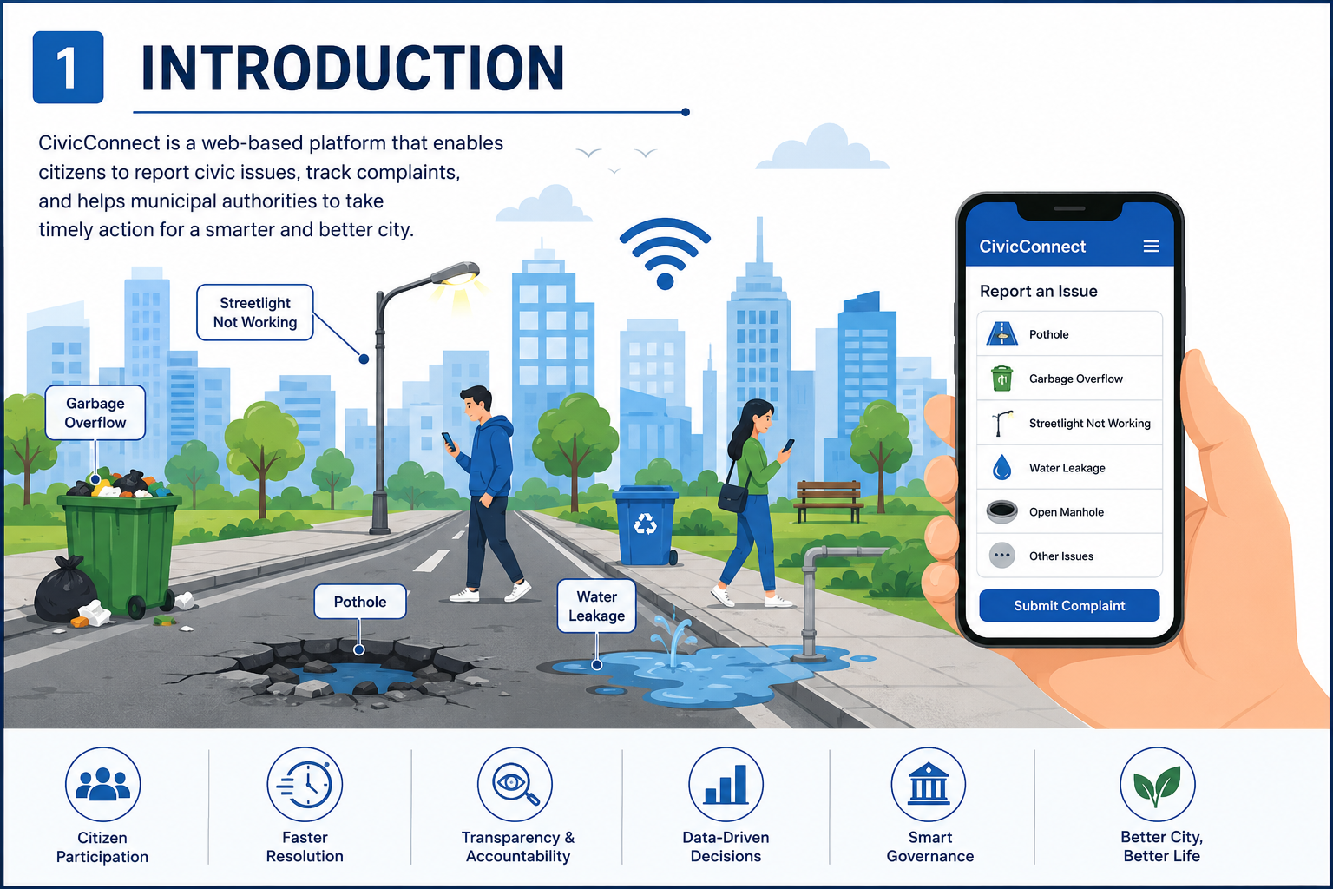
3. Introduction / Background
📝 Background
[ Insert supporting image / domain diagram here ]
Rapid urbanization has increased the number of civic issues in cities.
Problems like potholes, garbage overflow, water leakage, broken streetlights, and open manholes affect public safety and daily life.
Existing complaint methods such as phone calls, WhatsApp, and social media are unorganized and difficult to track.
CivicConnect is a web-based platform that enables citizens to report issues, track complaint status, and helps municipal authorities manage complaints efficiently.
Sanjivani COE | Department of Computer Engineering | Mini Project Proposal | T.Y. B.Tech Computer Engineering
3

Slide 4
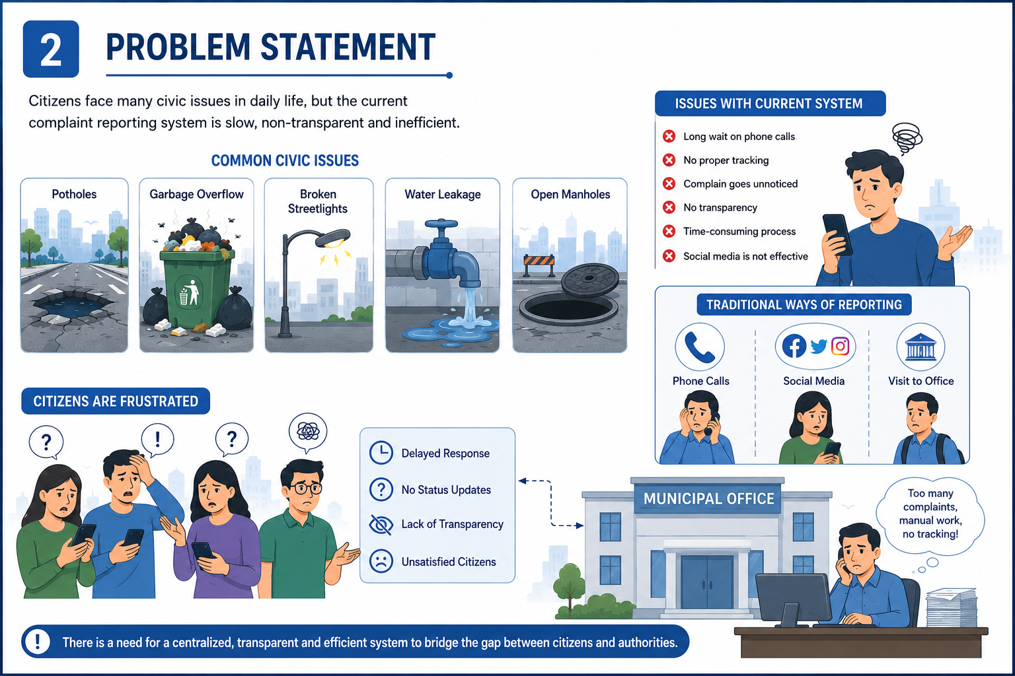
4. Problem Statement
📝 Problem Definition
Citizens face difficulty in reporting civic issues through traditional methods.
There is no centralized platform to manage and monitor complaints.
Duplicate complaints and lack of transparency delay the resolution process.
Citizens are often unaware of the progress of their complaints.
Municipal authorities also face challenges in assigning and tracking complaints effectively.
Sanjivani COE | Department of Computer Engineering | Mini Project Proposal | T.Y. B.Tech Computer Engineering
3

Slide 5
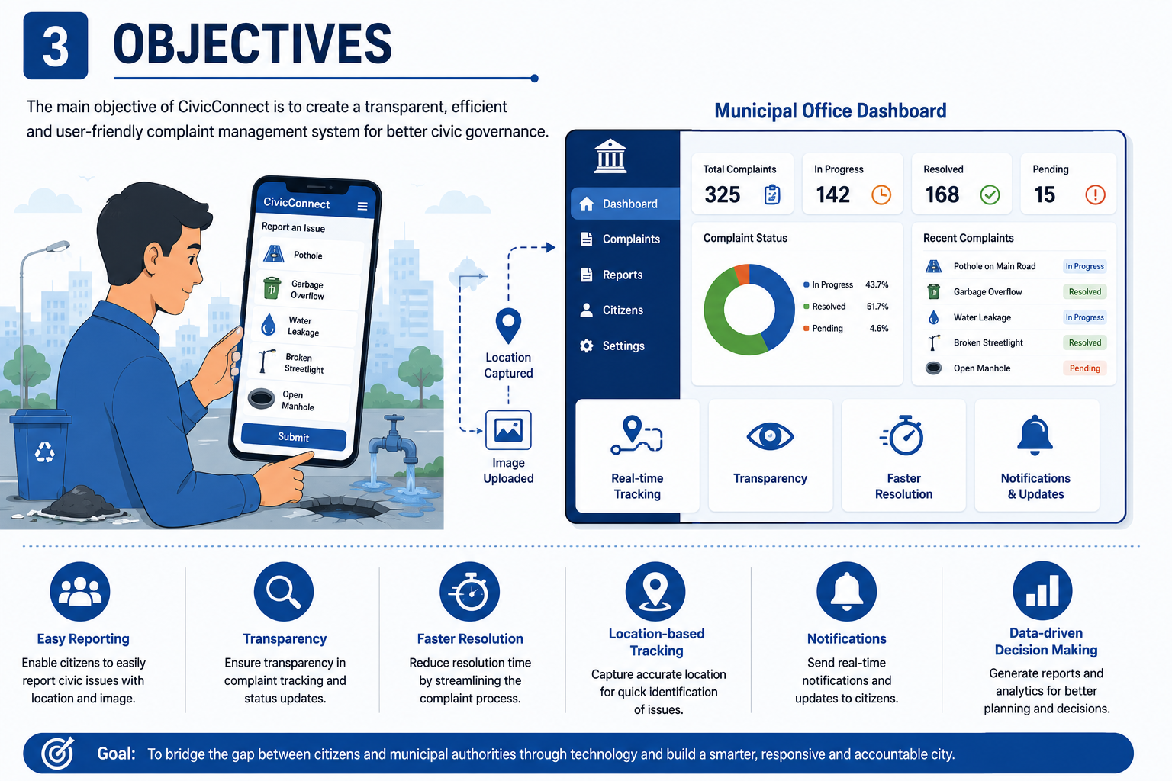
5. Objectives
🎯 SMART Objectives
[ Insert objectives / goal diagram here ]
Develop an online platform for reporting civic issues.
Allow citizens to upload images and location details of the problem.
Provide real-time complaint status tracking.
Help municipal officers assign and resolve complaints efficiently.
Improve transparency, accountability, and communication between citizens and authorities.
Sanjivani COE | Department of Computer Engineering | Mini Project Proposal | T.Y. B.Tech Computer Engineering
3

Slide 6
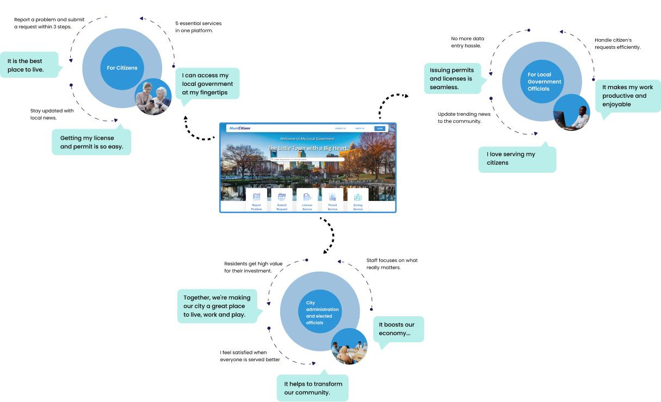
6. Scope of the Project
✅ Project Scope
[ Insert scope boundary diagram here ]
The system can be used by citizens, municipal officers, and administrators.
Citizens can register, submit complaints, and monitor complaint status.
Officers can manage complaints, update progress, and add remarks.
Administrators can monitor system performance and generate reports.
The system can be enhanced with AI, GIS, and notification services in the future.
Sanjivani COE | Department of Computer Engineering | Mini Project Proposal | T.Y. B.Tech Computer Engineering
3

Slide 7

7. Literature Survey
📚 Related Work
[ Insert comparison table / summary chart here ]
Existing complaint management systems mainly focus on complaint registration.
Most systems provide limited tracking and reporting features.
Many applications do not support duplicate complaint detection or analytics.
Recent research recommends digital platforms to improve transparency and public service delivery.
CivicConnect combines complaint management with dashboards and future AI capabilities.
Sanjivani COE | Department of Computer Engineering | Mini Project Proposal | T.Y. B.Tech Computer Engineering
3

Slide 8
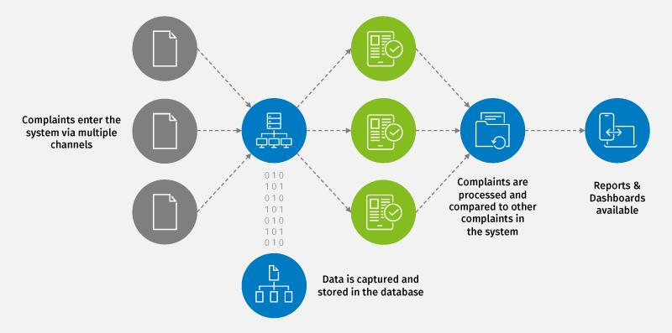
8. Proposed System / Methodology
⚙️ Approach & Modules
[ Insert System Architecture / Block Diagram Here ]
Users register and log in securely using role-based authentication.
Citizens submit complaints by entering issue details, location, and uploading images.
Complaint information is stored in a centralized MySQL database.
Officers review complaints, assign departments, and update their status.
Citizens receive real-time updates while administrators monitor reports and analytics.
Sanjivani COE | Department of Computer Engineering | Mini Project Proposal | T.Y. B.Tech Computer Engineering
3

Slide 9
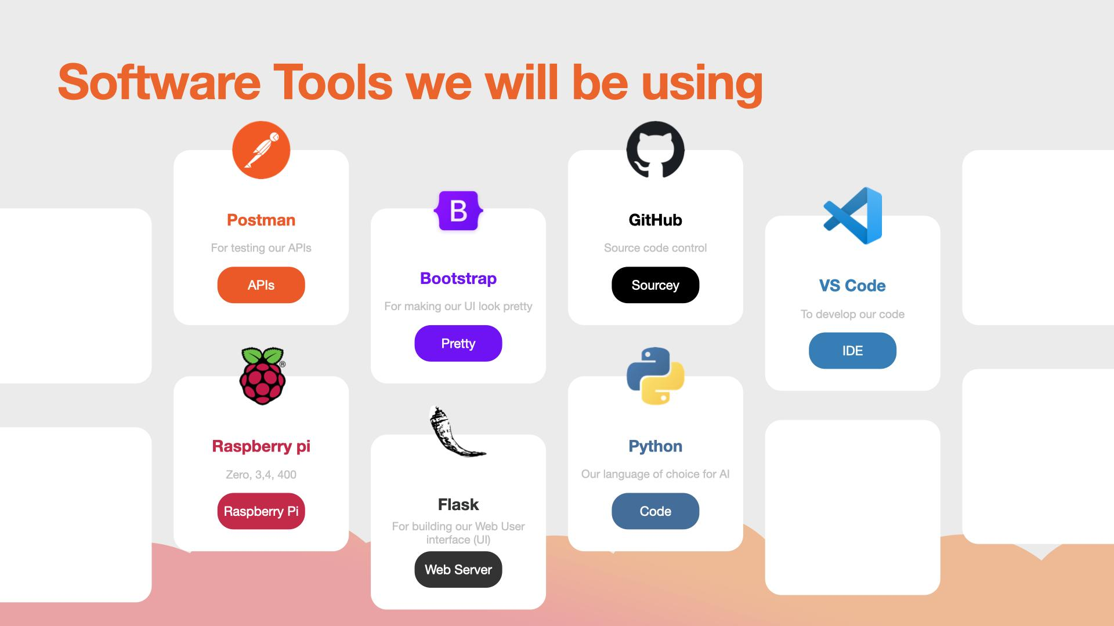
9. Tools and Technologies
🛠️ Tech Stack
[ Insert technology stack diagram here ]
Backend
Python 3.x
Flask Framework
Flask-Login / JWT Authentication
SQLAlchemy (ORM)
Frontend
HTML5
CSS3
Bootstrap
JavaScript
Database
MySQL
Development Tools
VS Code
Postman
Git & GitHub
Sanjivani COE | Department of Computer Engineering | Mini Project Proposal | T.Y. B.Tech Computer Engineering
3

Slide 10

10. Hardware & Software Requirements
💻 Requirements
[ Insert hardware setup / system requirement image here ]
Hardware Requirements
Processor: Intel Core i3 or higher
RAM: Minimum 8 GB
Storage: 256 GB SSD or higher
Internet: Stable Internet Connection
Software Requirements
Windows 10/11 or Linux
Python 3.x
Flask Framework
MySQL Server
Visual Studio Code
Postman (API Testing)
Git & GitHub
Web Browser (Google Chrome/Microsoft Edge)
Sanjivani COE | Department of Computer Engineering | Mini Project Proposal | T.Y. B.Tech Computer Engineering
3

Slide 11
11. Expected Outcomes
🏆 Deliverables
[ Insert expected result / output screenshot here ]
A centralized platform for reporting and managing civic complaints.
Faster complaint processing and resolution.
Improved transparency through real-time complaint tracking.
Better coordination between citizens and municipal departments.
Reports and analytics to support better decision-making.
Sanjivani COE | Department of Computer Engineering | Mini Project Proposal | T.Y. B.Tech Computer Engineering
3

Slide 12
12. Project Timeline / Work Plan
Milestone Schedule
1
Literature Survey & Requirement Analysis
2
Module 1 Development
3
Module 2 Development
Literature Survey
Requirement Gathering
System Design
Database Design
User Registration & Login
Authentication System
Complaint Registration
Image Upload
Officer Dashboard
Complaint Management
Status Updates
Remarks Management
4
Module 3 Integration
5
Integration & Testing
6
Documentation & Final Presentation
Admin Dashboard
Reports & Analytics
Department Management
Complaint Tracking
Module Integration
API Testing
Bug Fixing
Performance Testing
Deployed Product along with the Documentation
Sanjivani COE | Department of Computer Engineering | Mini Project Proposal | T.Y. B.Tech Computer Engineering
5

Slide 13
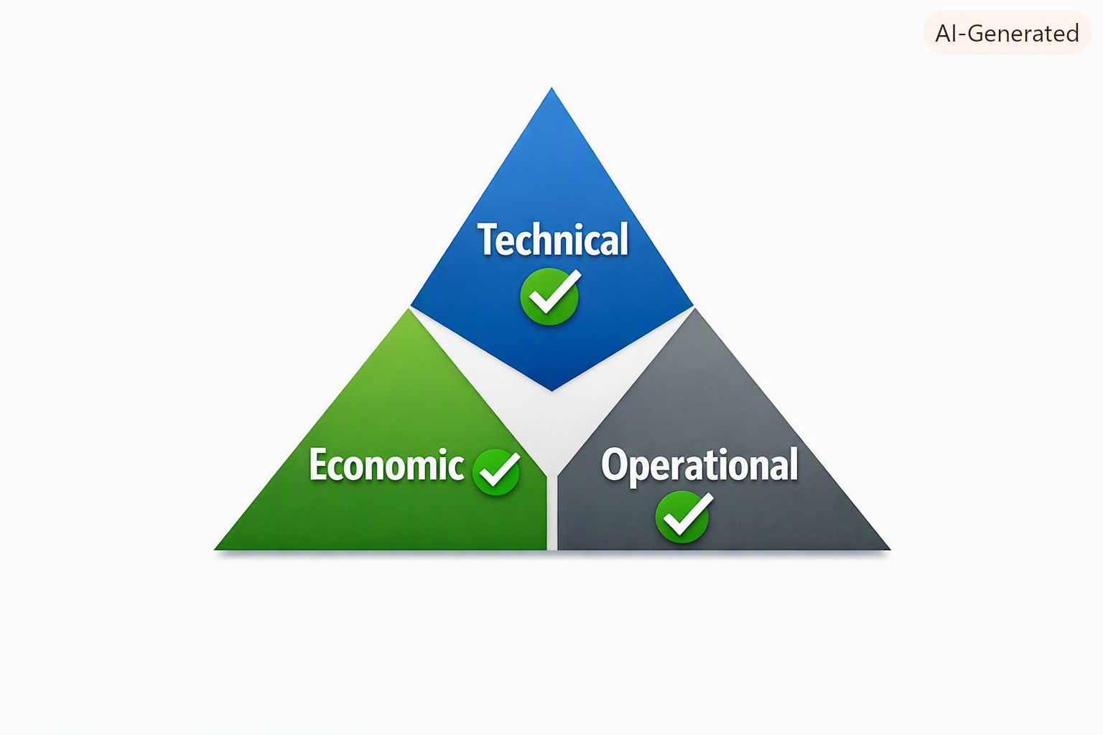
13. Feasibility Study
📊 Feasibility
[ Insert feasibility assessment summary here ]
Technical Feasibility
Developed using modern open-source technologies.
Economic Feasibility
Low development and maintenance cost.
Operational Feasibility
User-friendly interface for citizens and officers.
Schedule Feasibility
Can be completed within approximately 5 weeks.
Sanjivani COE | Department of Computer Engineering | Mini Project Proposal | T.Y. B.Tech Computer Engineering
3

Slide 14

14. Sustainable Development Goals (SDG) Mapped
🌍 SDG Alignment
[ Insert SDG icon(s) relevant to the project here ]
SDG 11 – Sustainable Cities and Communities
Promotes clean, safe, and well-managed urban environments.
Encourages active citizen participation in city governance.
SDG 16 – Peace, Justice and Strong Institutions
Improves transparency and accountability in public services.
Strengthens trust between citizens and government authorities.
Sanjivani COE | Department of Computer Engineering | Mini Project Proposal | T.Y. B.Tech Computer Engineering
3

Slide 15

15. References
📖 IEEE Format
[ Insert additional reference / citation notes here ]
Smart Cities Mission, Government of India
Spring Boot Documentation
Oracle Java Documentation
MySQL Documentation
IEEE Xplore Digital Library
Google Scholar
Sanjivani COE | Department of Computer Engineering | Mini Project Proposal | T.Y. B.Tech Computer Engineering
3

Slide 16
Sanjivani College of Engineering, Kopargaon
(An Autonomous Institute, Affiliated to SPPU, Pune)
Department of Computer Engineering, NBA Tier-1 Accredited
Thank You
www.sanjivanicoe.org.in

